Slide 1


Ministry of Education
Technological University (Taunggyi)
Department of Electronic Engineering
Design and Implementation of Voice Recognition Based Wireless Home Automation System using Zigbee
First Seminar
Supervised by
Daw Thet Su Honey
Date
10.6.2020 (Wednesday)
Presented by
Oakar Kyaw
6EC-13

Slide 2
Outlines of Presentation
Introduction
Aim and objectives
Overall Block Diagram of the Proposed System
Operation of the Overall System
Implementation Procedure
Literature Review
Hardware and Software Requirements
Conclusion
Next plan (or) Future plan
Time Schedule
References

Slide 3
Introduction
Home automation will be necessary in modern era .
Home automation is the digital connectivity among different appliances .
Compared to other wireless protocols , zigbee wireless protocol offer less complexity , reduce resource requirement and low power consumption etc..
The main purpose of this research is to facilitate elderly and disabled people with an easy to use home automation system.
This research allows to control house hold appliances from a centralized control unit which is wireless and control lights ,fans ,air conditioners ,television sets, electronic doors etc.…..
The base station unit takes decisions and sends the commands to remote station by zigbee transceiver and performs further operation.

Slide 4
Aim and Objectives
Aim
To design and implement Voice Recognition Based Wireless Home Automation using Zigbee.
Objectives
To provide the security to the home and control the electrical appliances in the home from the remote place using zigbee technology.
To design a home controlling system using voice commands.
To provides a user friendly interface especially for vision impaired user.

Slide 5
Overall Block Diagram of the Proposed System
Zigbee Transceiver
Module
External 5V
Power Supply
4-channel relay
LED
Fan
Gas Sensor
Arduino Uno
Bluetooth
Buzzer
Module
Servo motor
Door
LCD
Mobile Phone
Fig.1 Overall Block Diagram of the Proposed System

Slide 6
Operation of the Overall System
Power supply produce 5V and give it to the Arduino microcontroller.
The voice command is captured by Android phone connecting to the Bluetooth module.
Upon the recognition of voice, voice command is sent to the Arduino microcontroller and zigbee wireless communication protocol to the specified application address.
At receiver side, zigbee will receive the voice command and Arduino microcontroller can turn on or off relay controlling circuit depending on the receive voice command.
Buzzer will be on when the gas is detected by the gas sensor.
LCDs will display all of the voice command.

Slide 7
Implementation Procedure
Studying home automation research journal and paper
Studying zigbee module technique and gas sensor
Installing Arduino IDE software on window 10.
Studying how to code program of home automation using zigbee
Setting up transmitter and receiver hardware
Testing gas sensor and zigbee module
Implementing program for the system
Operating the overall system output.

Slide 8
Literature Review
Ref No | Type | Title | Controller | Components | Function
1 | Project Report 2016 | Wireless Home Automation system using IOT | Microcontroller | IoT ESP8266WIFI Module , LM117 voltage regulator, power supply , ULN 2003 relay driver , temperature sensor , resistor , capacitor , connector , LED, Fan | To control all the devices of smart home through internet protocols
2 | Project Report 2017 | Voice controlled home automation | Arduino | Arduino Board , Relay Module , Bluetooth module ,Breadboard, Android Phone , LED | To build a perfect companion for someone who is elderly and physical-disabled

Slide 9
Literature Review I
Introduction
IoT based home automation is the system that uses ESP8266 Wifi module to control basic home function and features .
Home automation using IoT differs from other system by allowing the user to operate the system through internet connection.
Operation of the System
LM117 is used for providing power supply to the ESP8266 Wifi module.
Wifi module provides command ULN2003 relay drive to drive relays.
Relays operate to turn on/off LED and Fan.
Temperature sensor is used to measure the amount of heat or even coldness that is generated by an object.

Slide 10
Continued.
Power supply
ULN 2003 Relay Driver
Relay
LED
LM117 Voltage Regulator
IoT ESP8266 Wifi Module
Relay
Fan
Temperature sensor
Fig.2 Overall Block Diagram of Wireless Home Automation using IoT

Slide 11
Literature Review II
Introduction
Voice controlled home automation using Arduino helps the users to control any electronic device using device control app on their Android smartphone.
The android app sends commands to the controller through wireless communication.
Operation of the system
User gives a command to Android phone connecting with HC05 Bluetooth module.
Bluetooth module transmits and receives data serially that can be read by the microcontroller.
Relay is used to control home appliances such as LED , Fan .
External 5V is used to provide power supply to relays.
LCD display is used to monitor the operation of the system.

Slide 12
Continued.
Power supply
External 5V
LED
Bluetooth module
Arduino Uno
Relay
Fan
Mobile Phone
LCD
Fig.3 Overall Block Diagram Of Voice Control Home Automation using Arduino

Slide 13
Hardware and software Requirements
Hardware
Power supply
Bluetooth Module (HC05)
Zigbee Module
Xbee explorer regulated board
Arduino UNO
Gas sensor (MQ2)
Buzzer
4-channel relay
Fan
LCD
LED
Servo motor
Software
Arduino IDE software
XCTU software

Slide 14
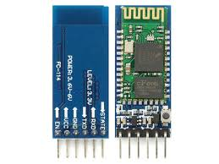
HC05 Bluetooth Module
HC-05 module is an easy to use Bluetooth SPP (Serial Port Protocol) module, designed for transparent wireless serial connection setup
HC-05 is used for many applications like wireless headset, game controllers, wireless mouse, wireless keyboard and many more consumer applications.
HC-05 communicates with microcontroller using serial port (USART).
Fig.4 HC05 Bluetooth Module

Slide 15
Continued.
Serial Bluetooth module for Arduino and other microcontrollers
Operating Voltage: 4V to 6V (Typically +5V)
Operating Current: 30mA
Range: <100m

Slide 16
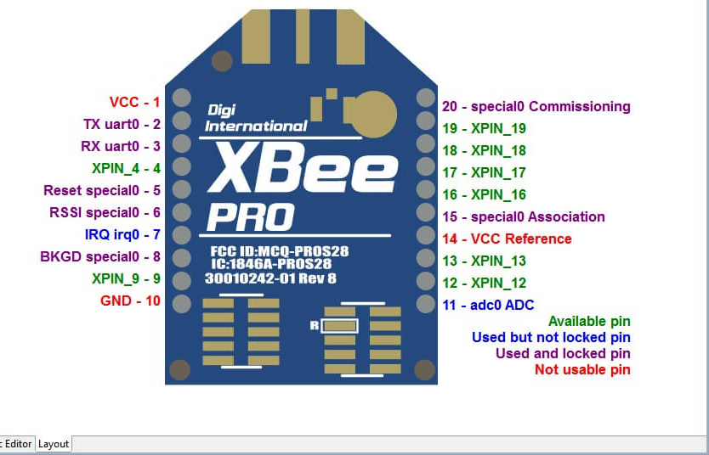
Zigbee Module
ZigBee is a specification for high level communication protocols using small, low-power digital radios for personal area networks.
ZigBee is designed for devices which require simple wireless networking and don't need high data transfer rate
It can be used as sensor network, information displays, home- and industrial automatic systems, etc.
Fig.5 Zigbee Module

Slide 17
Continued.
Network Device Types : Coordinator (routing capable), Router, End Device
Network Size (theoretical of nodes) : Up to 65,000
Radio Technology : IEEE 802.15.4-2011
Frequency Band / Channels : 2.4 GHz and 16 channels
Data Rate : 250 Kbits/sec
Communication Range (Average) : Up to 300+ meters (line of sight)
Low Power Support : Sleeping End Devices

Slide 18
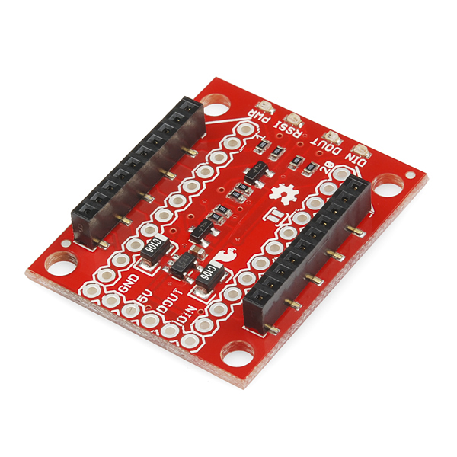
Xbee explorer Regulated board
Xbee explorer Regulated board takes care of the 3.3V regulation, signal conditioning, and basic activity indicators (Power, RSSI and Din/Dout activity LEDs).
It translates the 5V serial signals to 3.3V so that it can connect a 5V (down to 3.3V) system to any XBee module.
Fig.6 Xbee explorer regulated board

Slide 19
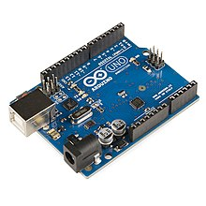
Arduino UNO
Arduino Uno is an open-source microcontroller board based on the Microchip ATMEGA328P microcontroller and developed by Arduino.cc.
The board is equipped with sets of digital and analog input/output (I/O) pins that may be interfaced to various expansion boards (shields) and other circuits.
The board has 14 digital I/O pins (six capable of PWM output), 6 analog I/O pins, and is programmable with the Arduino IDE (Integrated Development Environment), via a type B USB cable.
Fig.8 Arduino UNO

Slide 20
Continued.
Microcontroller : ATMEGA328
Operating Voltage : 5V
Input Voltage :7V or 12V
Digital I/O pins : 14pins ( of which 6 provide PWM output )
Analog input pins : 6 pins
DC current : 40mA
DC current : 50mA
Flash Memory : 32KB
SARM : 2KB
EEPROM : 1KB
Clock Speed : 16MHZ

Slide 21
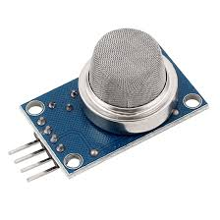
MQ2 Gas Sensor
MQ2 gas sensor is an electronic sensor used for sensing the concentration of gases in the air such as LPG, propane, methane, hydrogen, alcohol, smoke and carbon monoxide.
It contains a sensing material whose resistance changes when it comes in contact with the gas.
Fig.9 Gas Sensor

Slide 22
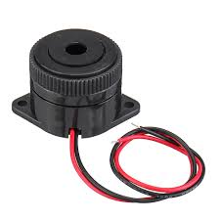
Buzzer
Buzzer or beeper is an audio signaling device, which may be mechanical, electromechanical, or piezoelectric (piezo for short).
Buzzer include alarm devices, timers, and confirmation of user input such as a mouse click or keystroke.
Fig.10 Buzzer

Slide 23
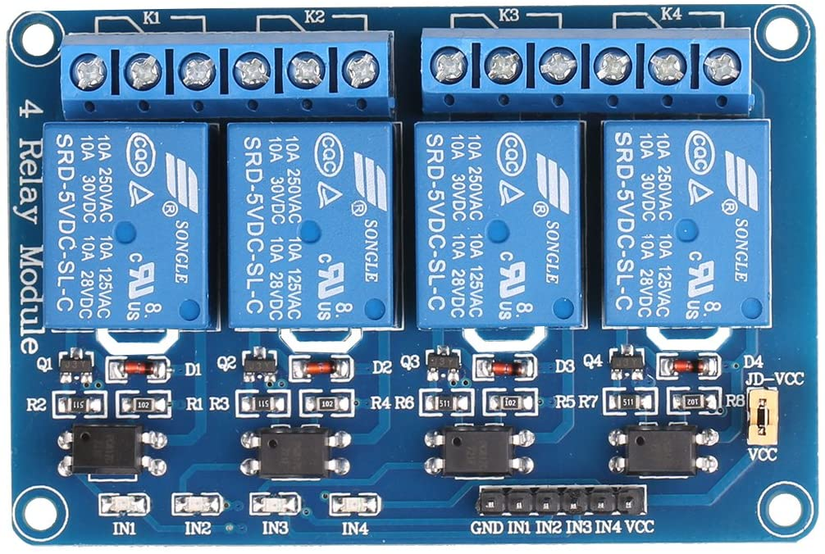
4-Channel Relay
The 4 Channel Relay Module is a convenient board which can be used to control high voltage, high current load such as motor, solenoid valves, lamps and AC load.
It is designed to interface with microcontroller such as Arduino, PIC and etc.
Fig.11 4-Channel Relay

Slide 24
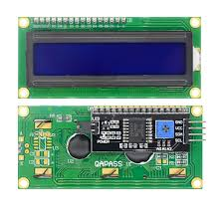
Liquid Crystal Display
An LCD (Liquid Crystal Display) screen interfacing with I²C module is an electronic display module and has a wide range of applications.
A 16x2 LCD interfacing with I²C module means it can display 16 characters per line and there are 2 such lines
Fig.12 LCD Display

Slide 25
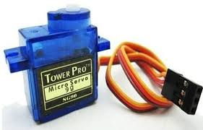
Servo motor
A servo motor is an electrical device which can push or rotate an object with great precision.
Servo motor can rotate and object at some specific angles or distance.
It is made up of simple motor which run through servo mechanism
Fig.13 Servo Motor

Slide 26
Next Plan (or) Future Plan
Future Plan
Setting up hardware and testing sensor .
Writing program in Arduino IDE software
Operating some output .

Slide 27
Title Seminar | Introduction about this thesis | 17th February 2020
First Seminar | Literature review , operation and components | 10th June 2020
Second Seminar | Test and result some output | July 2020
Third Seminar | Pre-explanation of the overall system | September 2020
Final Defense | Explanation of the overall system | October 2020

Slide 28
Conclusion
Nowadays , home automation research become a very useful research for the adults and physically disabled persons, who are not able to do various activities at home efficiently and need assistant to perform those tasks.
This research eliminate the complication of wiring in case of wired automation.
Home automation using zigbee considers amount of power saving and compatible with future technologies.
Zigbee network provides secure access to home.

Slide 29
References
Control home security system website.[cited 2010 14th October].Available:
http://www.itechnews.net/2008/05/20/control-home-security-system/[4].R.Gadalla/
The Z-Wave technology available at http://www.z-wavealliance,org/technolgy
Zigbee Home Automation available at http://www.zigbee.org/Standards/
Home Security systems, home security products , and home alarm systems available at http://www.adt.com

Slide 30
Thank You For your attention

